Slide 1
Health and Materials

Slide 2
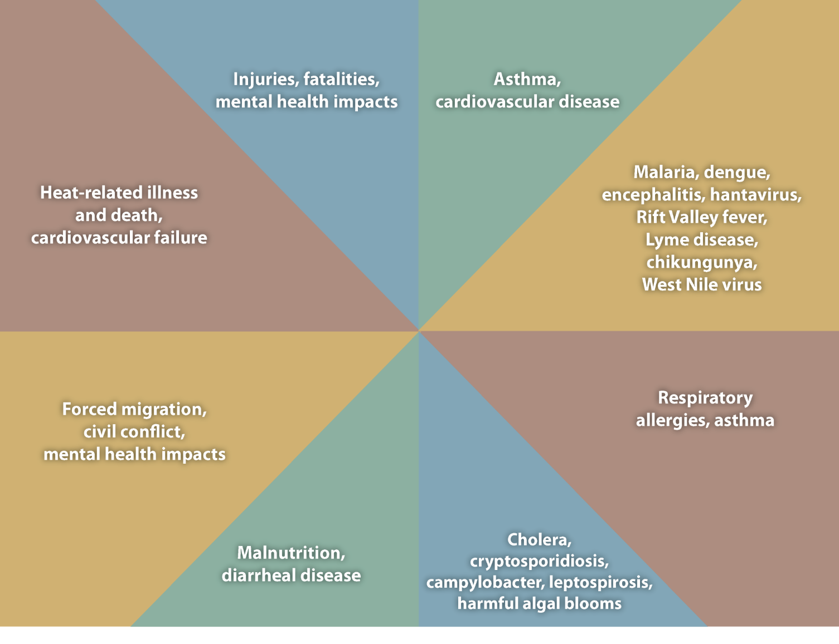
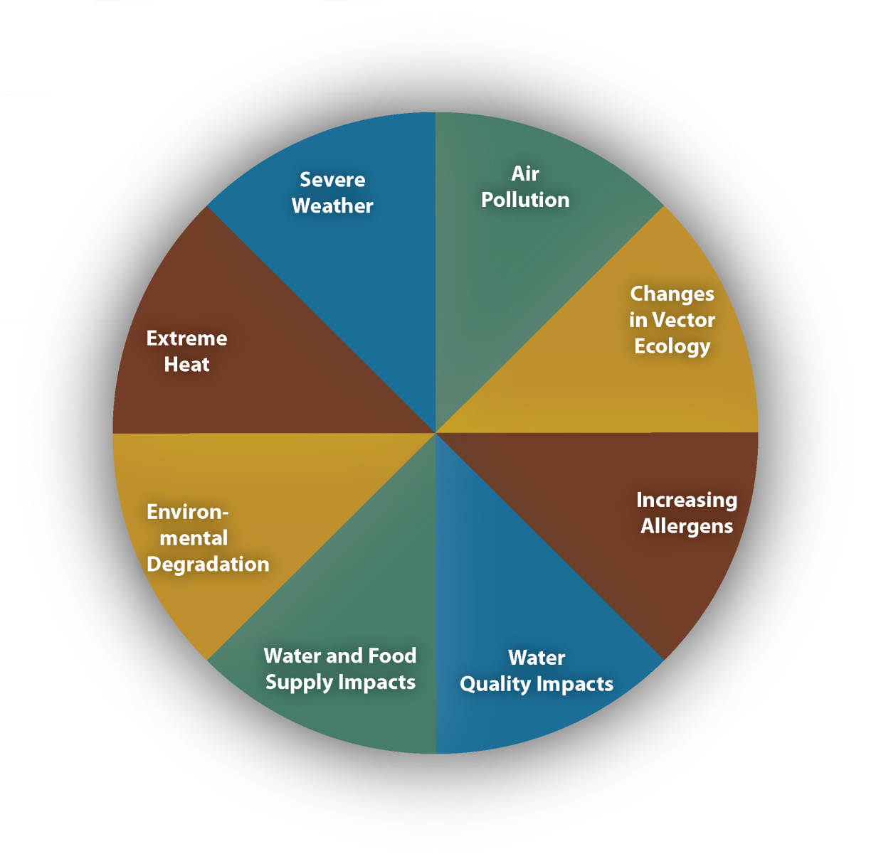
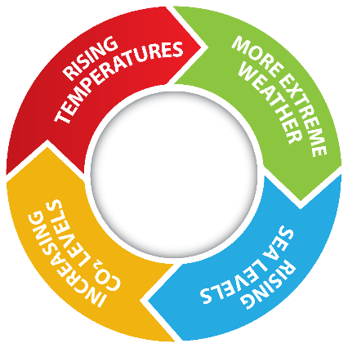
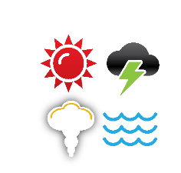
Impact of Climate Change on Human Health

Slide 3
This is how we see it.
We use three lenses to make decisions on materials. These are our guideposts.
Embodied Carbon Green Chemistry Circular Economy
Health and Materials
Measuring Embodied Carbon in everything you make and choose.
Choosing products and services based in Green Chemistry.
Partnering with businesses engaged in Circular Economy practices.
Embodied Carbon
Green Chemistry
Circular Economy

Slide 4
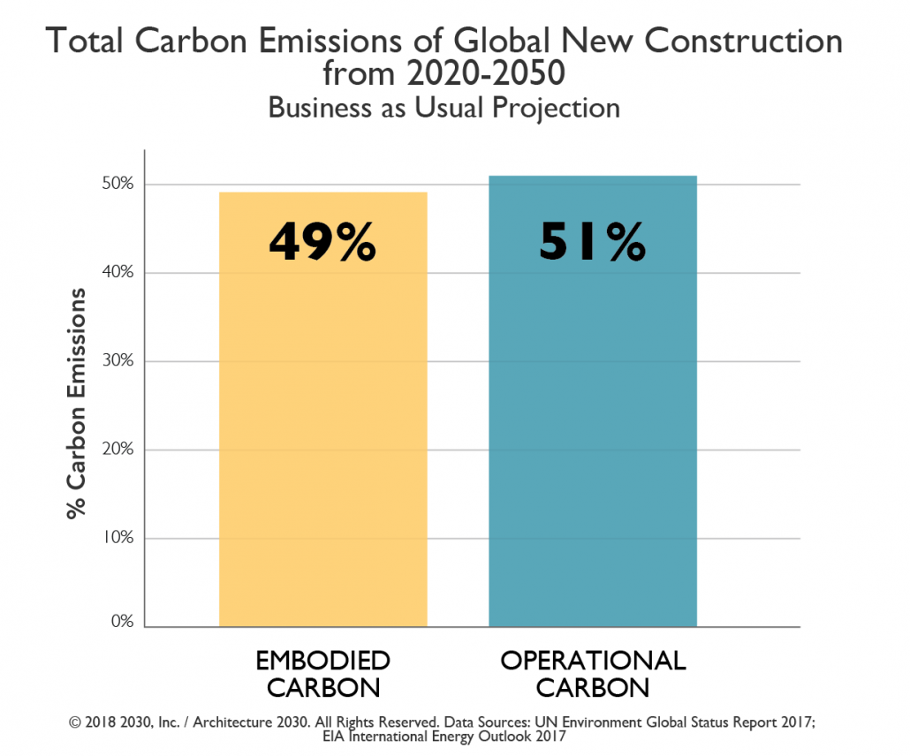
Embodied Carbon
Health and Materials
The measurement of embodied energy and carbon for a material, with consideration for the total amount of greenhouse gases released from
raw material extraction to the end of its useful life.

Slide 5
Health and Materials
Green Chemistry
Design of products and processes that reduce or eliminate hazardous substances.

Slide 6
Health and Materials
Circular Economy
A business model that replaces all virgin raw materials (which includes mined minerals and petroleum based chemicals) with either bio-based or recycled materials.

Slide 7
Creating +Positive spaces for the K-12 Environment.
BETTER PRODUCTS (and Service!) Positively leverage your budget to create spaces that meet your business needs.
HAPPIER PEOPLE Positively impact the well-being of people in the spaces you create.
HEALTHIER PLANET Positively impact our planet by working with Interface to create a climate fit for life.

Slide 8
Thank You
Interface
Gary Tingey
Account Executive
Gary.Tingney@interface.com
425.200.2730
nora by Interface
Jim McGinnis
Account Executive
Jim.McGinnis@nora.com
425.891.3897

